Slide 1

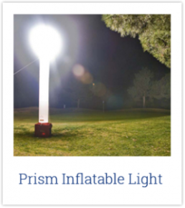
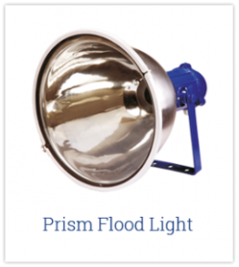
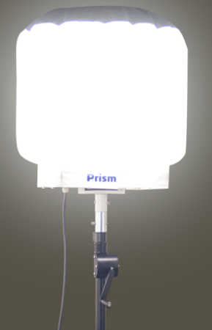
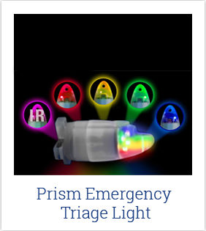
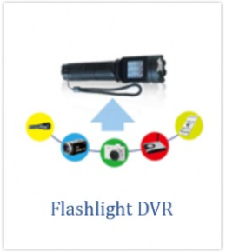
Prism Balloon Light

Slide 2
PRISM LIGHTING PRODUCT PORTFOLIO:
Prism Inflatable Lighting System
USA Patent # 8328377
USA Patent # 8939593
Prism Balloon Light
Prism Flood Light (Stainless Steel)
Prism Emergency Triage Light (Multiple Patents)
Flashlight DVR (Patented)

Slide 3
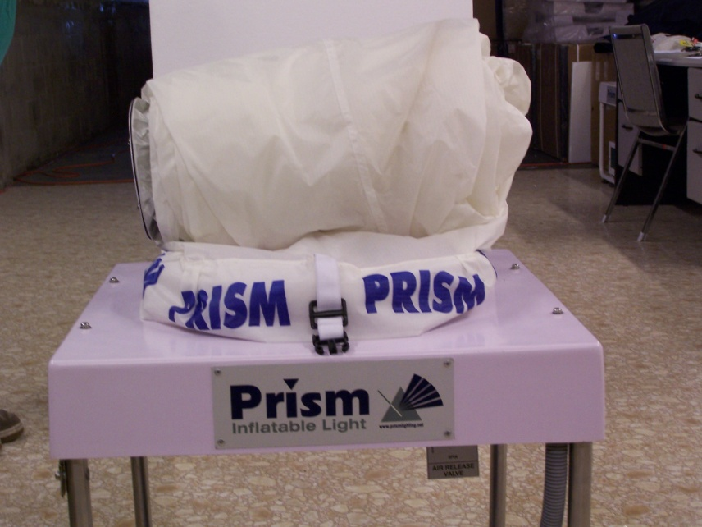
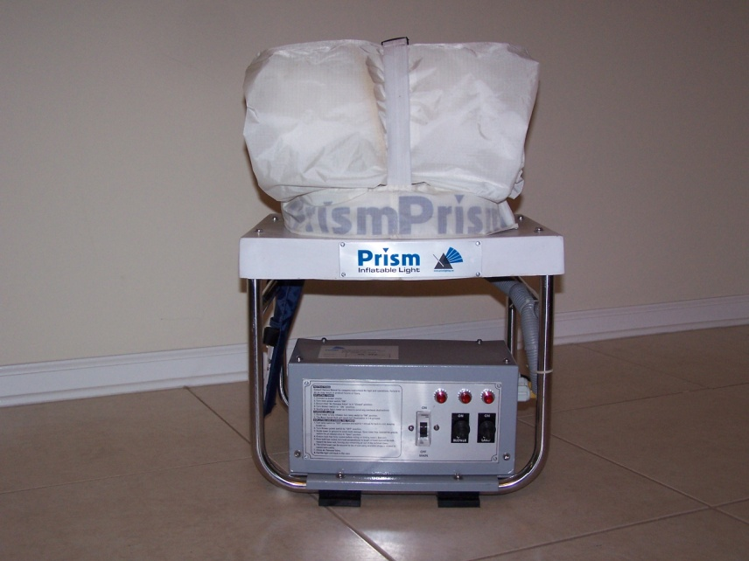
PIL Models: Quick Overview.
PIL 1000 –
15 feet high, 1000W bulb, 20 secs to inflate, 3 mins to illuminate, covers17,000 sq feet and comes with storage case, stabilizing poles, rain cover & tool kit.
PIL 1000G –
PIL 1000 and Honda Eu2200i generator (110V, 60 Hz market only)
PIL NiteLite –
9 feet high, 250W bulb, 5 secs to inflate, 3 mins to illuminate, covers 700 sq yards and comes with storage case, tool kit.

Slide 4
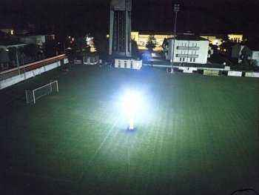
The PIL Overview
The Prism Inflatable Light System is designed so that one person, in total darkness, can illuminate up to 17,000 square feet in less than 3 minutes!!

Slide 5
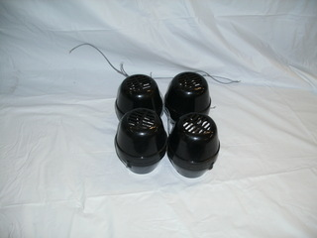
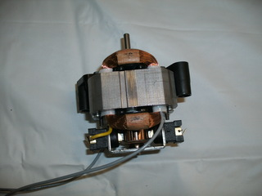
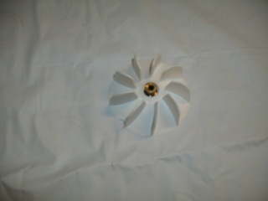
The Blowers & Fans
A series of axial fans constantly inflate air into the supporting structure, in which sufficient pressure is generated to guarantee the necessary stability to the system, bringing the light source up to the best operative level.
It is recommended that after 6 – 8 hours of constant use, the system should be shut down for about 30 minutes to allow the motors & bulb to cool

Slide 6

The Balloon
The balloon is made of an unique nylon material.
It is a Spinnaker 90 material, sometimes called Ripstop.
It is most closely identified with parachute cloth
It has special coating inside to work under 225 degrees Celsius.

Slide 7
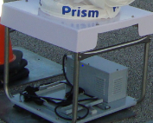
The Frame
The Stainless Steel frame, which houses the electrical control gear and blower motors, comes with or without a generator installed on it.
Without the generator you plug it into any regular power outlet.
With the generator you have a built-in power source.

Slide 8
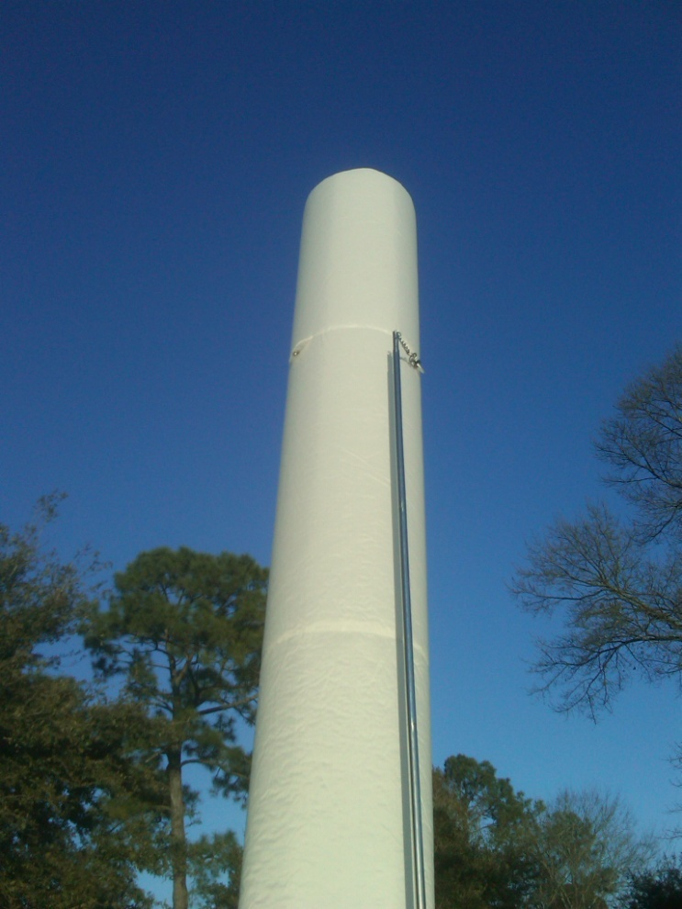
High Winds
The PIL is rated to be able to withstand sustained wind speeds of up to 70 km per hour. It comes with the ability to attach the stainless steel stabilizing poles to prevent from falling.
3 Sand bags & guy ropes are also provided for use in high winds

Slide 9
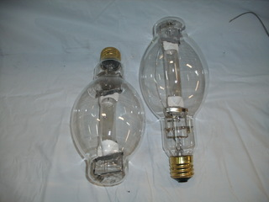
The Bulb
The bulbs are either 1000W or 250W metal halide bulbs. The 1000W bulb illuminates up to 17,000 square feet.
As with all metal halide bulbs they take about 3 minutes to reach their full luminosity and once they are turned off they have to cool down (about 10 minutes) before they can be turned back on.

Slide 10
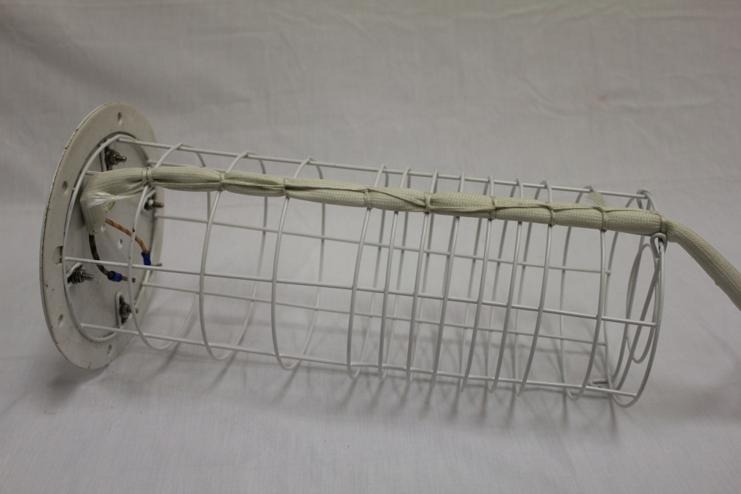
The Protective Cage
Is designed to enclose, anchor and protect the Metal Halide bulb

Slide 11
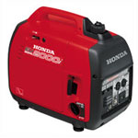
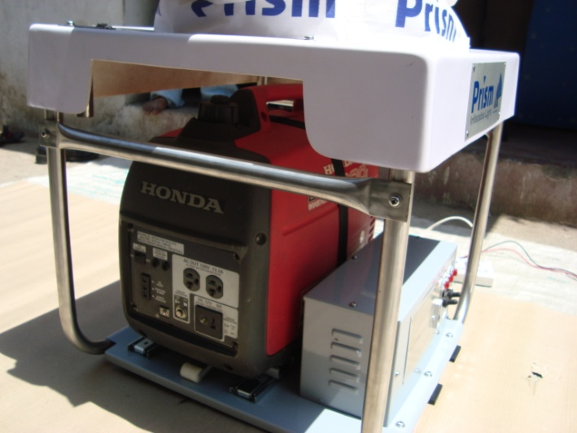
The Generator
For 110V, 60 Hz MARKET -
The generators are Honda Inverter Generators. The PIL 1000 unit uses the Honda EU2200i generator (weighs about 47 lbs dry weight).
The generator is about the size of a medium-sized briefcase and slides into the frame so that the system remains one complete unit
For 220V, 50 Hz MARKET –
Use local equivalent generator (Honda Eu20i)

Slide 12
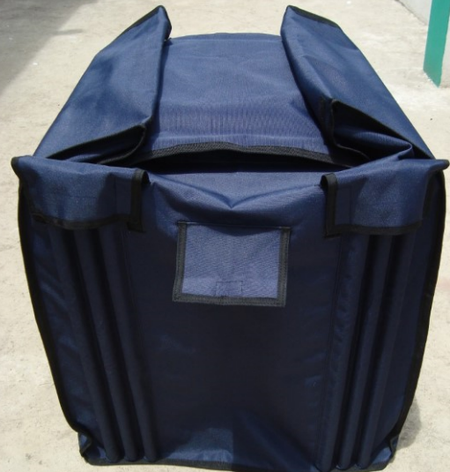
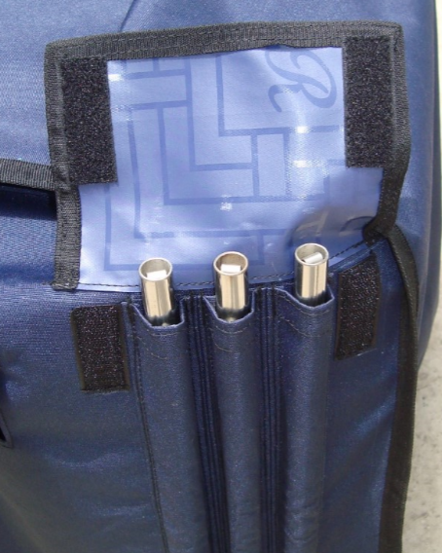
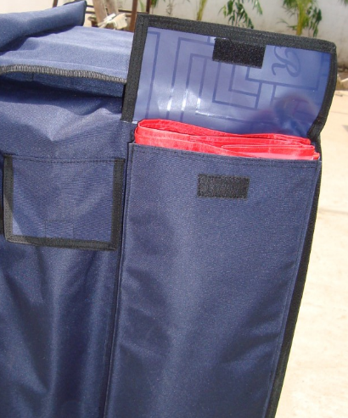
Storage Case – Rain cover & Stabilizing Poles

Slide 13
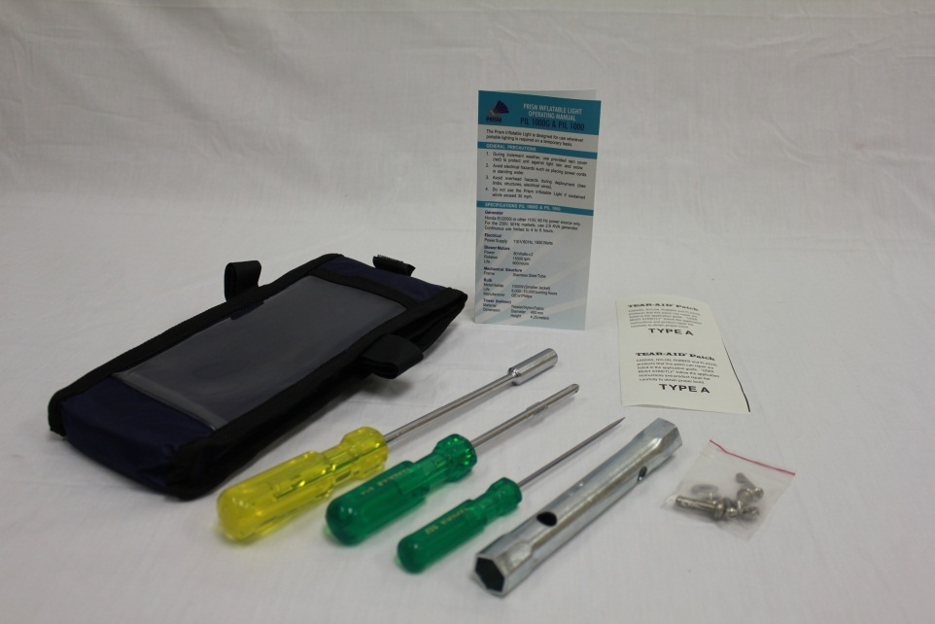
Repairs & Spares
A mending toolkit is provided along with some basic tools to operate the tower.
For major issues, please call Prism Lighting Services at
001-904-880-9900
or email: sales@prismlighting.net
Check out the 3 min video at:
www.prismlighting.net

Slide 14
PRISM Dealer Family: (2018)
USA – 22 dealers
International – dealers in 27 countries
http://www.prismlighting.net/our-dealers/

Slide 15
Quality Control:
ZERO warranty replacements against manufacturing defects till date
(since 2003…)
Following ISO quality standards (thanks to Mr. R.L. Kothari, ISO Consultant)

Slide 16
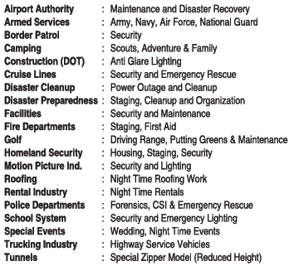
SCOPE OF APPLICATIONS:

Slide 17
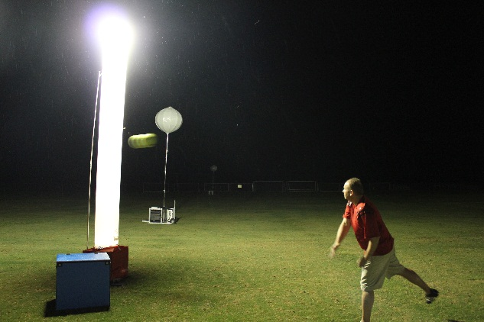
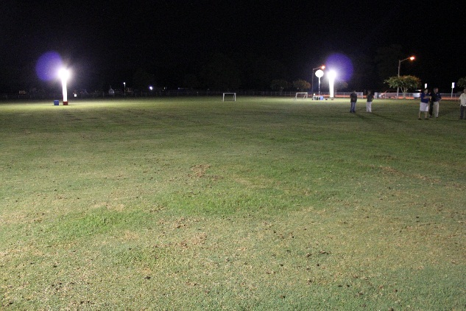
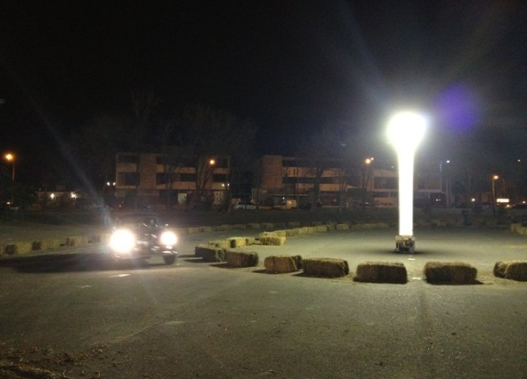
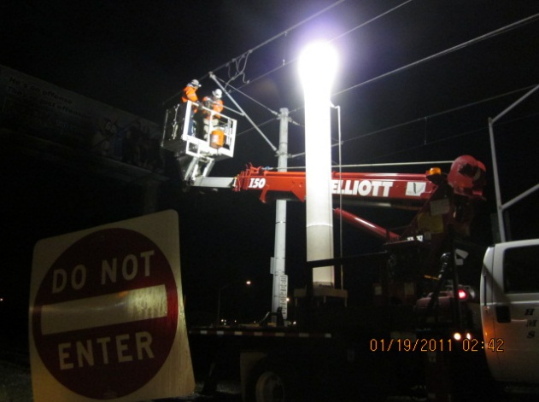
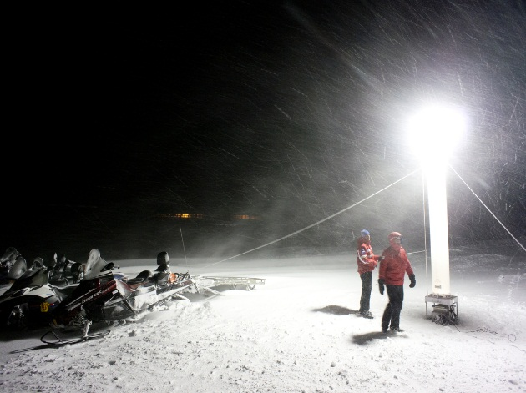
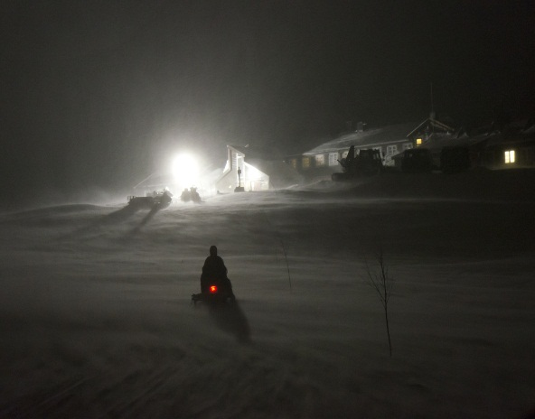
!! PIL IN ACTION !!

Slide 18
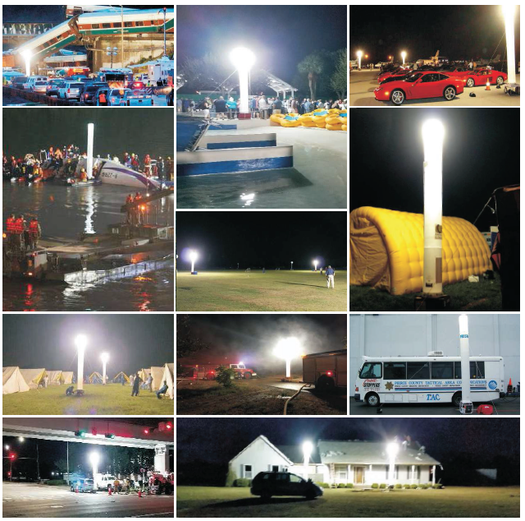

Slide 19
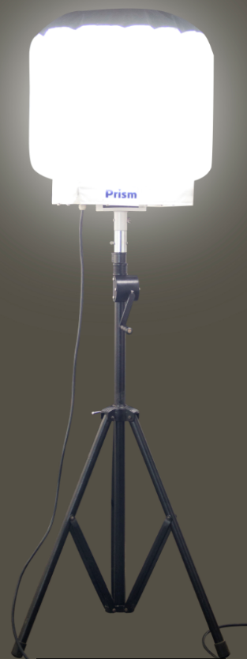
PRISM
BALLOON LIGHTS

Slide 20
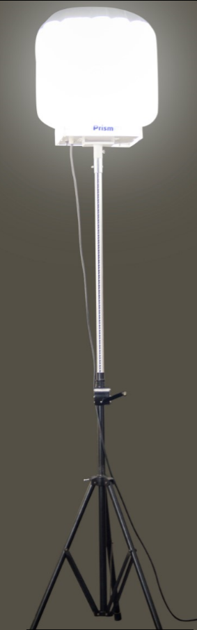
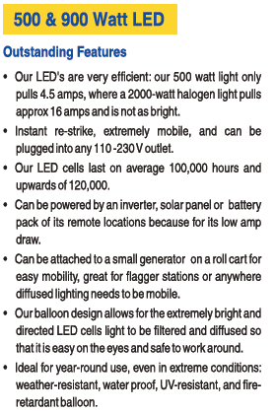

Slide 21
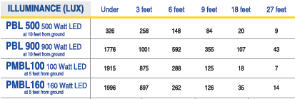
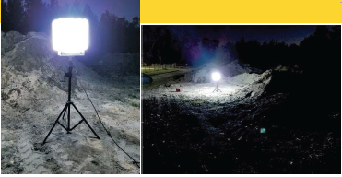
Long-lasting, Energy-saving lighting for Mobile Applications

Slide 22
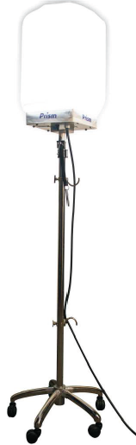
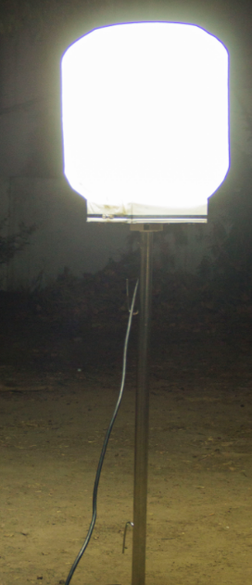
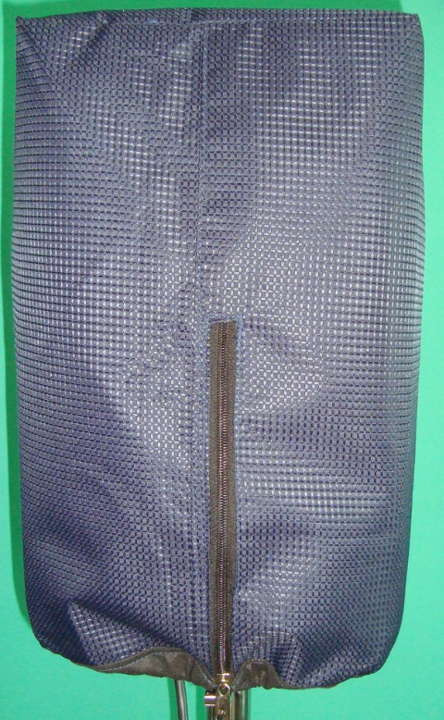
Prism Mini Balloon Light
100 W & 160 W LED

Slide 23
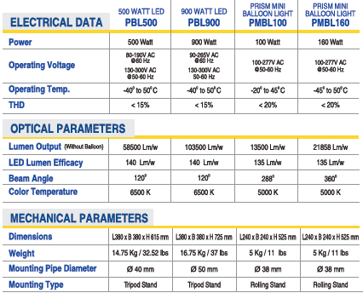
Technical Data

Slide 24
PRISM
EMERGENCY TRIAGE LIGHT

Slide 25
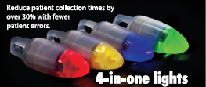
Prism Emergency Triage Light
Using Prism E/T Lights™, the purchasing agency saves a substantial amount of money for the following reasons:
Chemical light sticks have a shelf-life of about 2 years*, after which there is no guarantee that they will perform optimally and must be disposed of. Because of waste reduction, Prism E/T Lights™ are a greener option and reduce disposal costs
Prism E/T Lights™ have a battery shelf-life of 5 years.
While in storage, after 4 years the agency will have spent at least $144.00 in blue chemical light sticks as opposed to replacing a $3.00 battery for each Prism E/T Light™.
The storage cost is less for Prism E/T Lights™.
The transportation cost is less for Prism E/T Lights™.
Prism E/T Lights™ are reusable.
Prism E/T Lights™ may be serviced; the batteries and nosecones are replaceable.
Prism Emergency/Triage lights™ last from 3 to 8 days while continually illuminated, depending on color selection.

Slide 26
PRISM
FLOOD LIGHT

Slide 27
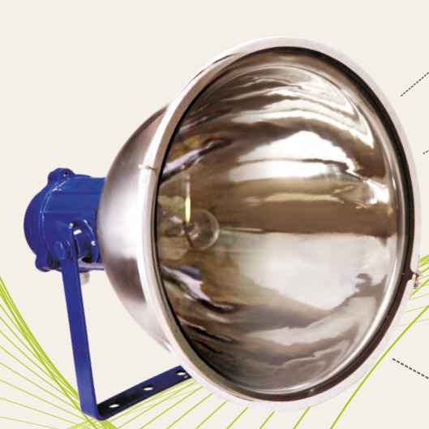

PRISM FLOOD LIGHT
Stainless Steel body & reflector
Toughened front glass
Front sealed ring
Ingress Protection – IP65
Model –
PFL 400 – 400W MH bulb
Control Gear – separate
Warranty – 5 years on reflector
Accessories available

Slide 28
PFL – Applications
Open cast mining
Construction
Boundary lighting
Replace existing flood light fixtures of 1000, 1500 W metal halide and halogen lamps
Prisons
Ships
Oil Refineries
Factories and large warehouses
Stadiums
Tower Lights

Slide 29
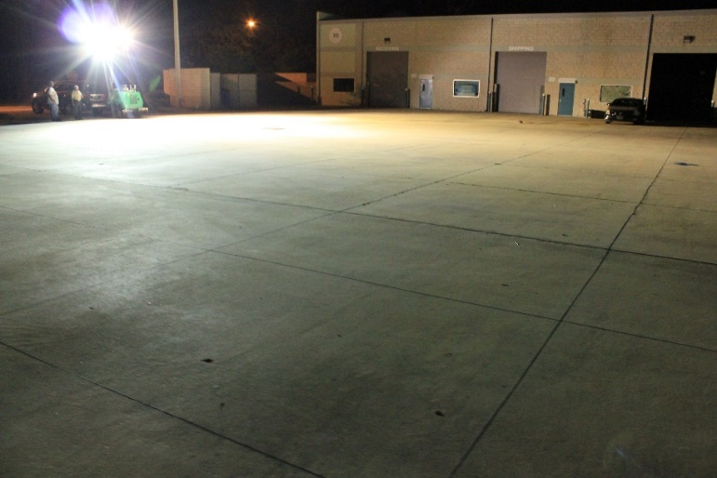
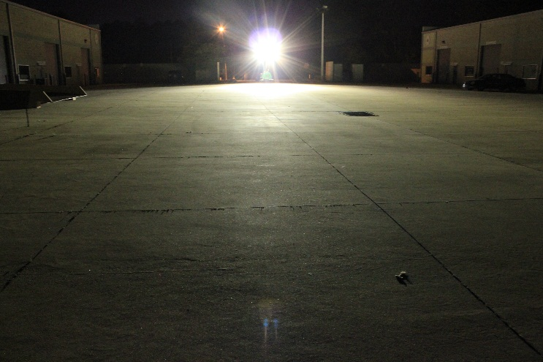
PFL 400 x 4 Illumination Levels –
1 Lux = 1 Lumen / sq. meter
Distance from mast | Illumination
(Feet.Inches) | (Lux)
15 | 3350
26.4 | 1550
37.8 | 512
49.2 | 251
60.6 | 143
72 | 97
83.4 | 67
94.8 | 50
106.2 | 38
117.6 | 31
129 | 25
140.4 | 21
151.8 | 18

Slide 30
FLASHLIGHT – DVR
(built in Digital Video Recorder)

Slide 31
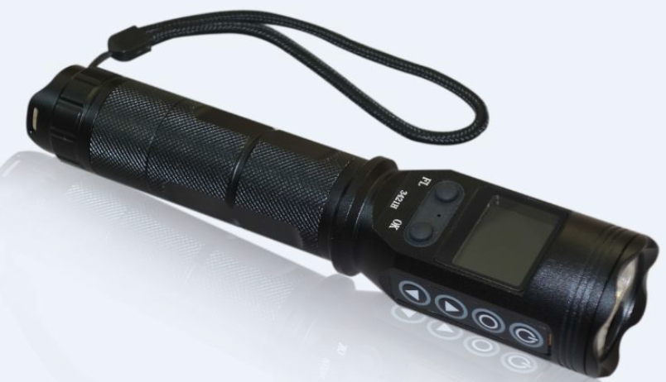
Model GD-3421H
Flashlight with Screen, LED light, video & audio recording, photographing and USB disk functions
Video resolution 1920X1080, H.264, CMOS senor. Picture resolution 4032X3024
1.5 inch LCD monitor which support real time watching and playback
System support multi-language setup
IP65 waterproof , extremely durable; water and crush proof
Removable 32GB SD card. Easily plug and play
Up to 5 hours of continuous use (LEDs + DVR), 24 hrs standby
Rechargeable large capacity Li-battery
ISO90001, Patent letter, CE, FCC

Slide 32
??? QUESTIONS ??? www.prismlighting.net
904-880-9900 sales@prismlighting.net
THANK YOU…

Slide 33
DEALER Requisites:
Execute the Prism Dealer Agreement (non-exclusive or exclusive)
Buy a demo unit of PIL 1000 + any other Prism products (at demo prices – 1st unit)
Dealer information will be published on www.prismlighting.net dealer web page
Prism shall guide with marketing, pictures, video clips, initial set of brochures, types of customers, applications etc.
Dealer to do trade shows, market, demo the product and inform Prism periodically for future sales efforts
Prism to do trade shows with dealer after some sales has been established and help them be more successful

